Slide 1
Early reading and Phonics
Intent and early implementation

Slide 2
Common thoughts on phonics...even today...including teachers!!!
“One size does not fit all”
“All children learn in different ways”

Slide 3
Anyone fancy reading this aloud?
Calceolaria integrifolia
Notes:
There are no pictures cues and no context cues. Only some form of phonics (print to sound decoding) will help the reader to lift these words off the page.
Thus, even adults need phonics knowledge and skills for new, challenging and hard to decode words.
Re the Year One Phonics Screening Check and its use of nonsense words, these are only the equivalent of real words which are not in the oral (spoken) vocabulary of the reader.
Even the ‘better’ Year One readers should be able to decode the nonsense words with no difficulty. The fact they are ‘nonsense’ is irrelevant to decodability.
Ask the parents to spell a multi-syllable word that you have made up.
For example, Skedringham (say it as ‘Skedringum’)
The parents will describe that they broke it into chunks, or syllables. In other words, they used their phonics skill.
Using phonics for reading and spelling are skills even of ADULT proficient readers and spellers.
We set children up for lifelong reading and spelling when we teach phonics rigorously.

Slide 4
“...all beginners have to come to terms with the same alphabetic principles if they are to learn to read and write...
...It cannot be left to chance, or for children to ferret out, on their own, how the alphabetic code works.”
Sir Jim Rose in response to common misunderstandings
(Final Report, March 2006)
Notes:
The idea that there is ‘one way’ to teach reading and spelling and for ‘all children’ goes against our deep-rooted passion to perceive and treat our children as individuals. Sir Jim Rose addresses these and other common mantras and perceptions in his independent national review which took place in 2005 and 2006 following a parliamentary inquiry into how to teach early reading. However, there isn’t just ‘one way’ to teach reading and we do all learn in different ways, but we now know that there is a ‘most-effective’ way of teaching reading and spelling which cannot be ignored - and also that some methods can lead to under-achievement and very flawed ‘reading profiles’. In effect, flawed teaching can cause or exacerbate dyslexia.
Thus, teachers have a duty to understand about the findings of research and to apply the very best evidence-informed practice to reading instruction.
Sir Jim Rose did an excellent job in his report to address head on the various mantras that reflect common misunderstandings in the field of reading instruction. These include that ‘one size does not fit all’ and ‘children learn in different ways’.
Rose pointed out that…. ‘all beginners…

Slide 5
The official current guidance in England:
Teachers should use Systematic Synthetic Phonics programmes and ‘cumulative’ decodable reading books for beginners.

Slide 6
What OFSTED say about early reading in their 2019 reviewed EIF
During deep dives into early reading. They will consider the extent to which:
direct, focused phonics is taught every day in Reception and throughout key stage 1
children read from books with the sounds they know, while they are learning to read
teachers and teaching assistants provide extra practice through the day for the children who make the slowest progress (the lowest 20%)
all children in Year 3 and above can read age-appropriate books
teachers instil in children a love of literature: the best stories and poems
However, we do not expect to see phonics in ‘continuous provision’ activities. This is a time to develop children’s talk, play and wider curriculum experiences. A ‘language-rich’ environment is just about talking with children, not building displays, or sticking on Post-it Notes.

Slide 7
What about our Phonics? We get good results.
Here are some OFSTED Quotes from reports of other schools that sound like a match to our reading and phonics under the new ofsted framework…
"Early reading and phonics remain areas for improvement, particularly for pupils who struggle."
"They have attempted to bring together several phonic schemes that do not match. This leads to inconsistencies from class to class."
"Pupils’ reading books are not always well matched to their reading stage. Books contain sounds they have not yet been taught. As a result, some pupils fall behind in their reading."
"There are not enough phonics experts across the staff team to help all pupils to learn to read from an early age."
"Staff try to develop pupils’ love of reading. Storytelling sessions occur daily, and these engage pupils well, but some of the books that staff read to pupils vary in quality."
Notes:
Our bottom 20% remain our bottom 20% through their whole learning journey through school.
We had several phonics schemes being used despite our policy being Letters and Sounds.
Pupil’s books were not adequately matched to their then Phase of Phonics teaching.
We teach Phonics well...but didn’t ever spend time consolidating the learning - especially once into Year 2 and onwards where Phonics is almost forgotten. We also did do much reading as a general rule.

Slide 8
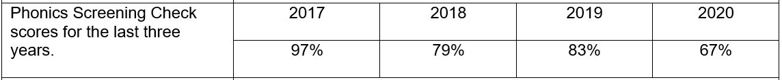
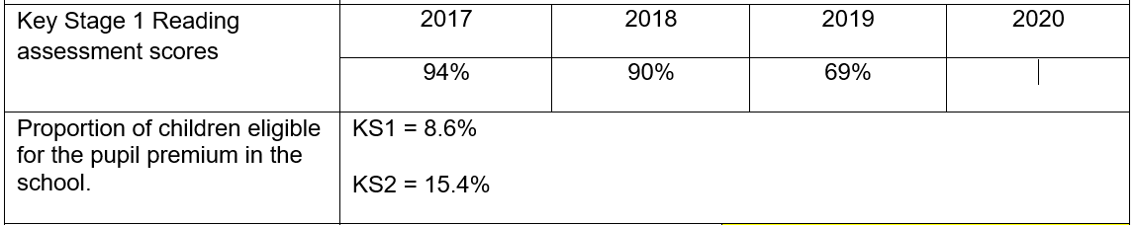
What does our data show?
Notes:
National Phonics: 2017 - 81% 2018 - 83% 2019 - 82%
National Reading: 2017 - 75.6% 2018 - 75% 2019 - 76%

Slide 9
Floppy’s Synthetic Systematic Phonics
Floppy’s Phonics is designed:
to help teach reading, spelling and handwriting with a two pronged systematic and incidental approach.
to inform parents and carers routinely and fully about their children’s reading, spelling,
handwriting and vocabulary development
to encourage and foster the work in partnership to maximise learning opportunities through accessing quality texts with greater independence.
Notes:
Incidental teaching is a huge part of the push - english and reading through the curriculum.

Slide 10
The Floppy’s Synthetic Systematic Phonics Teaching Principles
Teach:
KNOWLEDGE of the ALPHABETIC CODE
= letters linked to the sounds of speech
code is ‘reversible’, introduced ‘systematically’
THREE CORE SKILLS (and their sub-skills)
  ‘Sounding out and blending’ for reading
  Identifying sounds in words and allotting letters and letter groups for spelling
  Handwriting – forming letters correctly while saying the sounds
Notes:
For example: Only new and unknown words need to be sounded out and blended.
Once the sounds have been identified all-through-the-spoken-word, the learner needs to select the correct letters and letter groups which are code for the sounds.
Early handwriting is taught as part of the multi-sensory approach to phonics teaching. Hear the sound, say the sound, write the letter shape or letter group.]

Slide 11


Apply:
Apply growing phonics knowledge and skills to CUMULATIVE words, sentences and texts for reading, spelling and writing
[cumulative = words which ‘match’ the alphabetic code taught to date]
Apply to reading and writing
in the wider curriculum
Notes:
mention any cumulative, decodable reading books you use in school.
Draw attention to the cover notes in the books if these refer to blending words, and words which might be more challenging to read and therefore require adult support.]

Slide 12
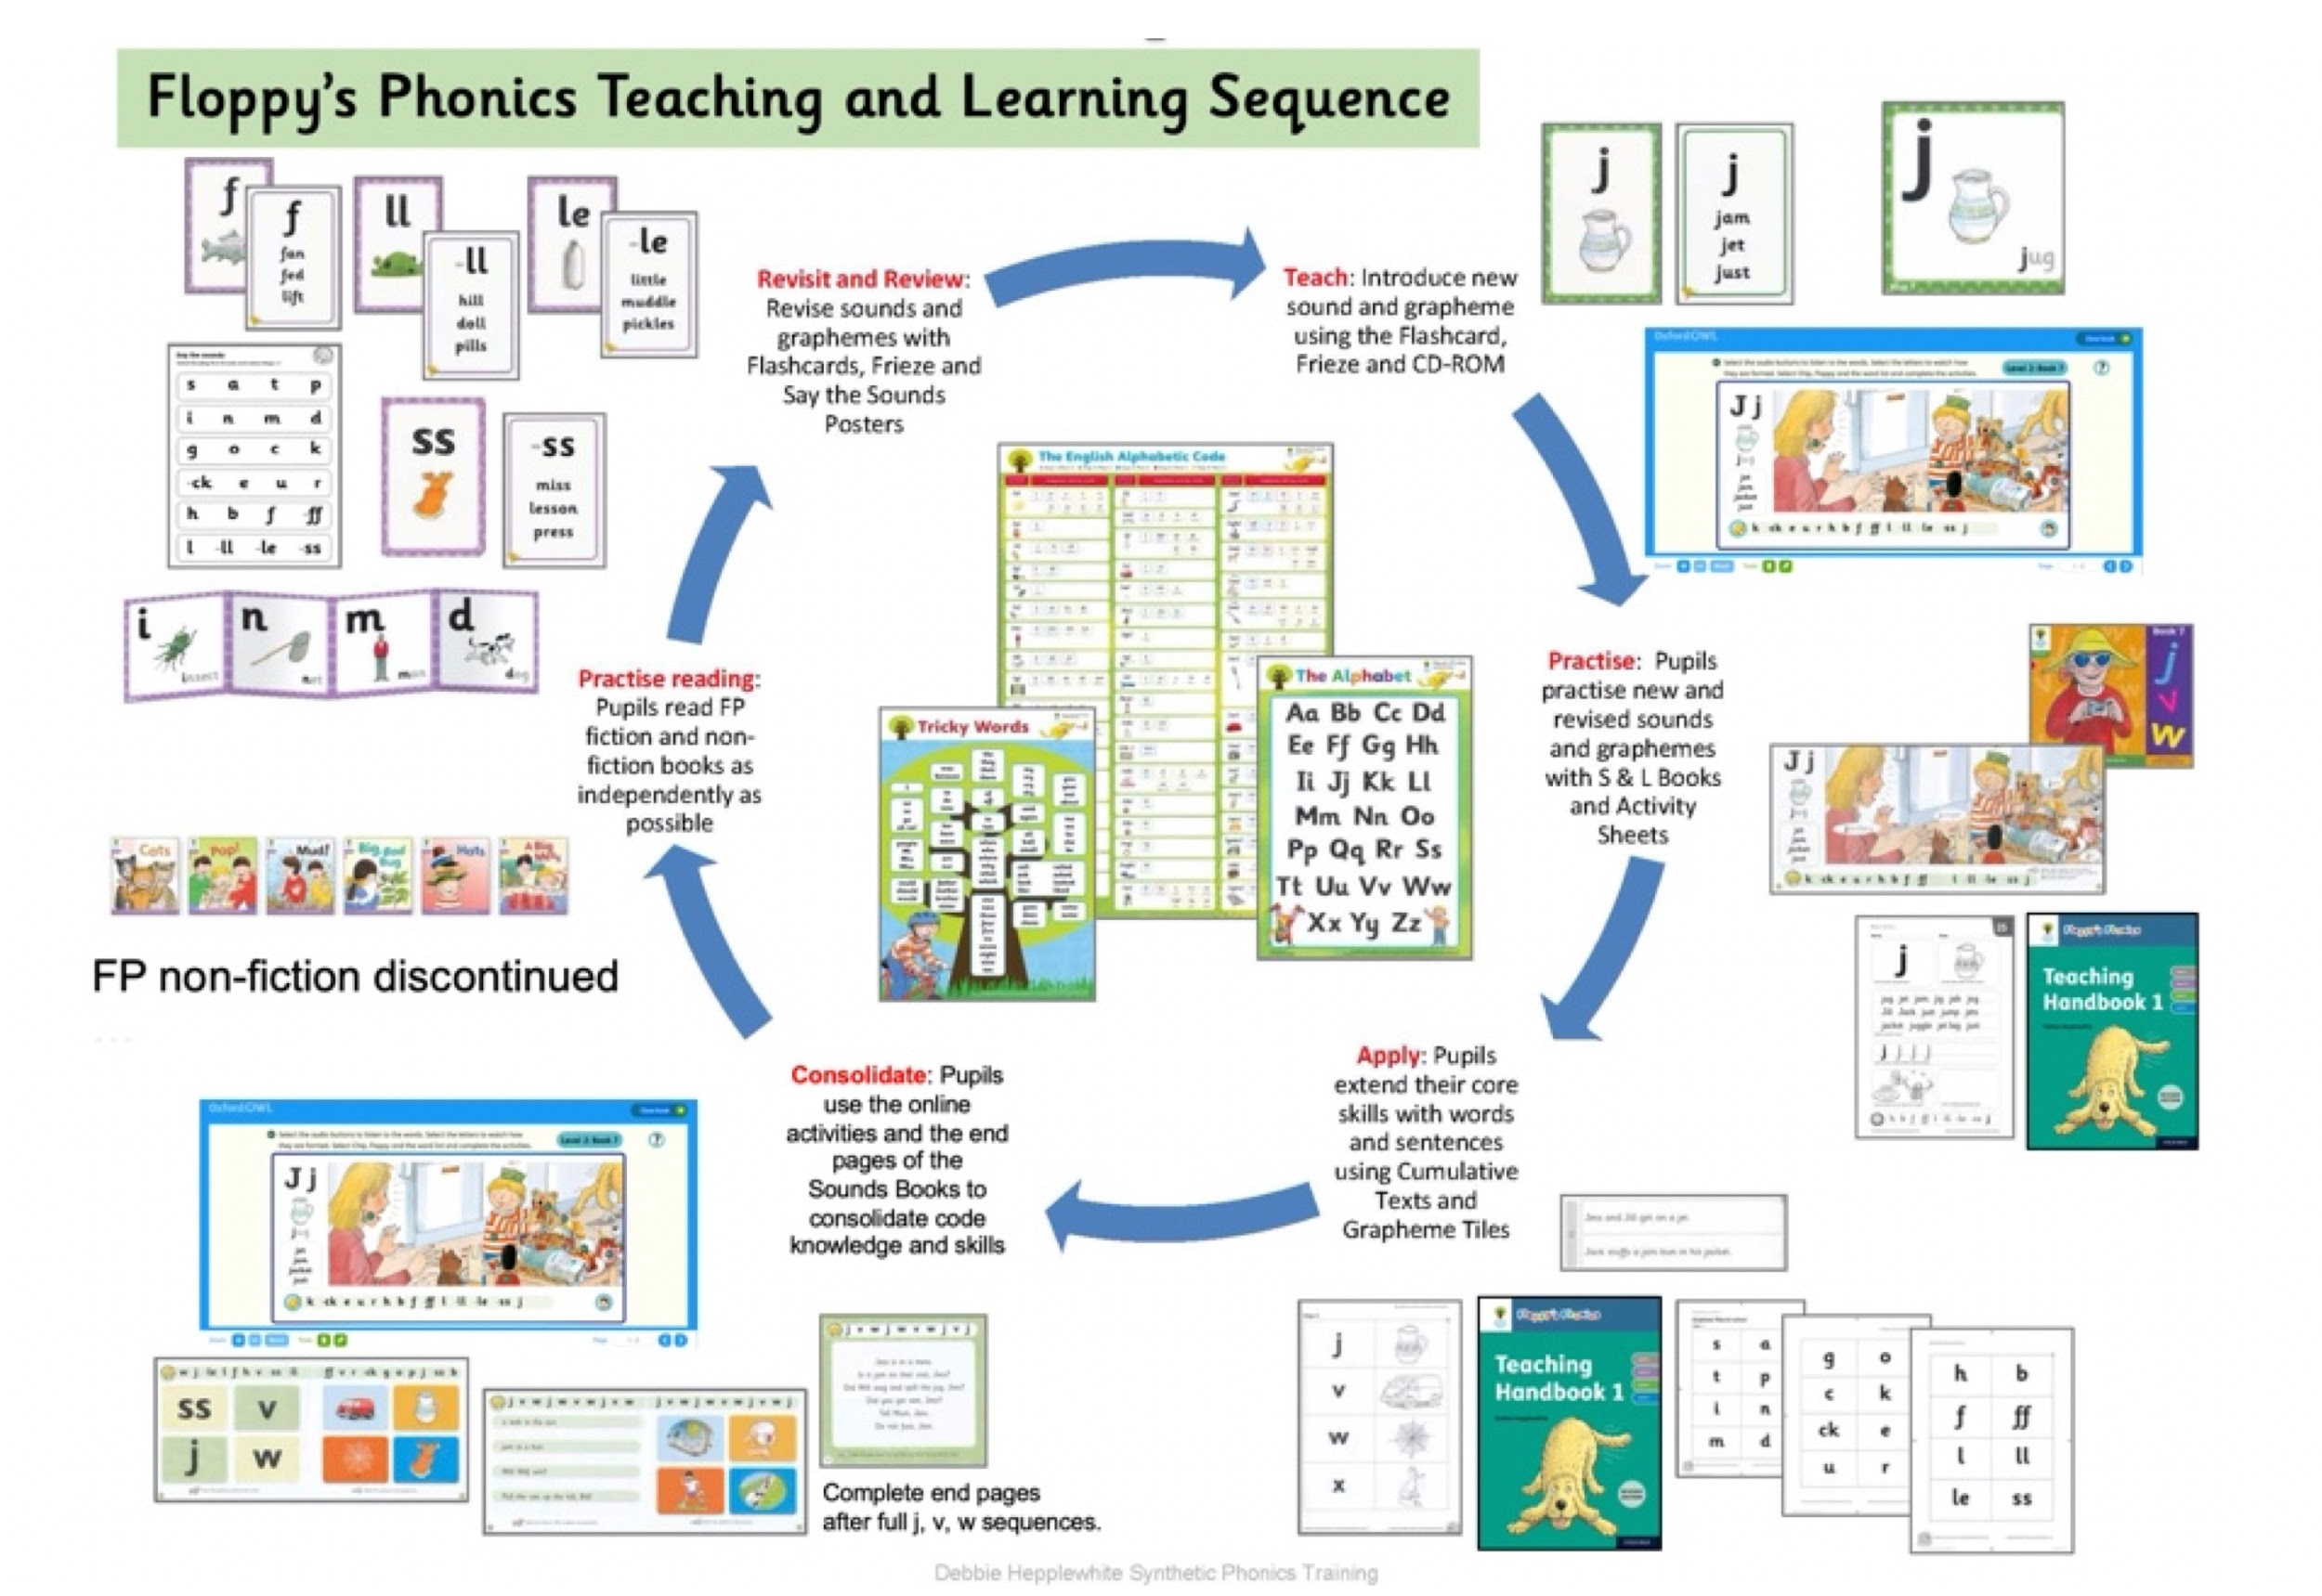
Teaching and Learning Sequence
Notes:
On-line platform to support learning in school and at home.

Slide 13
What will this mean for us at home?
One phonetically decodable book perfectly matched to the level your child is currently working at.
A worksheet matched to this book - to apply their phonics skills in written form.
A reading book that is to be enjoyed for pleasure - not fully decodable - that can be read to them, with them or by them.
The focus is now more about understanding and digging deeper into the vocabulary, the story, the characters and the events taking place.
There is also the introduction of an Ebook library to support the phonics teaching via the Oxford Owl Platform.
Notes:
Incidental teaching is a huge part of the push - english and reading through the curriculum. Be creative and use the pictures to interact with and ask questions.

Slide 14
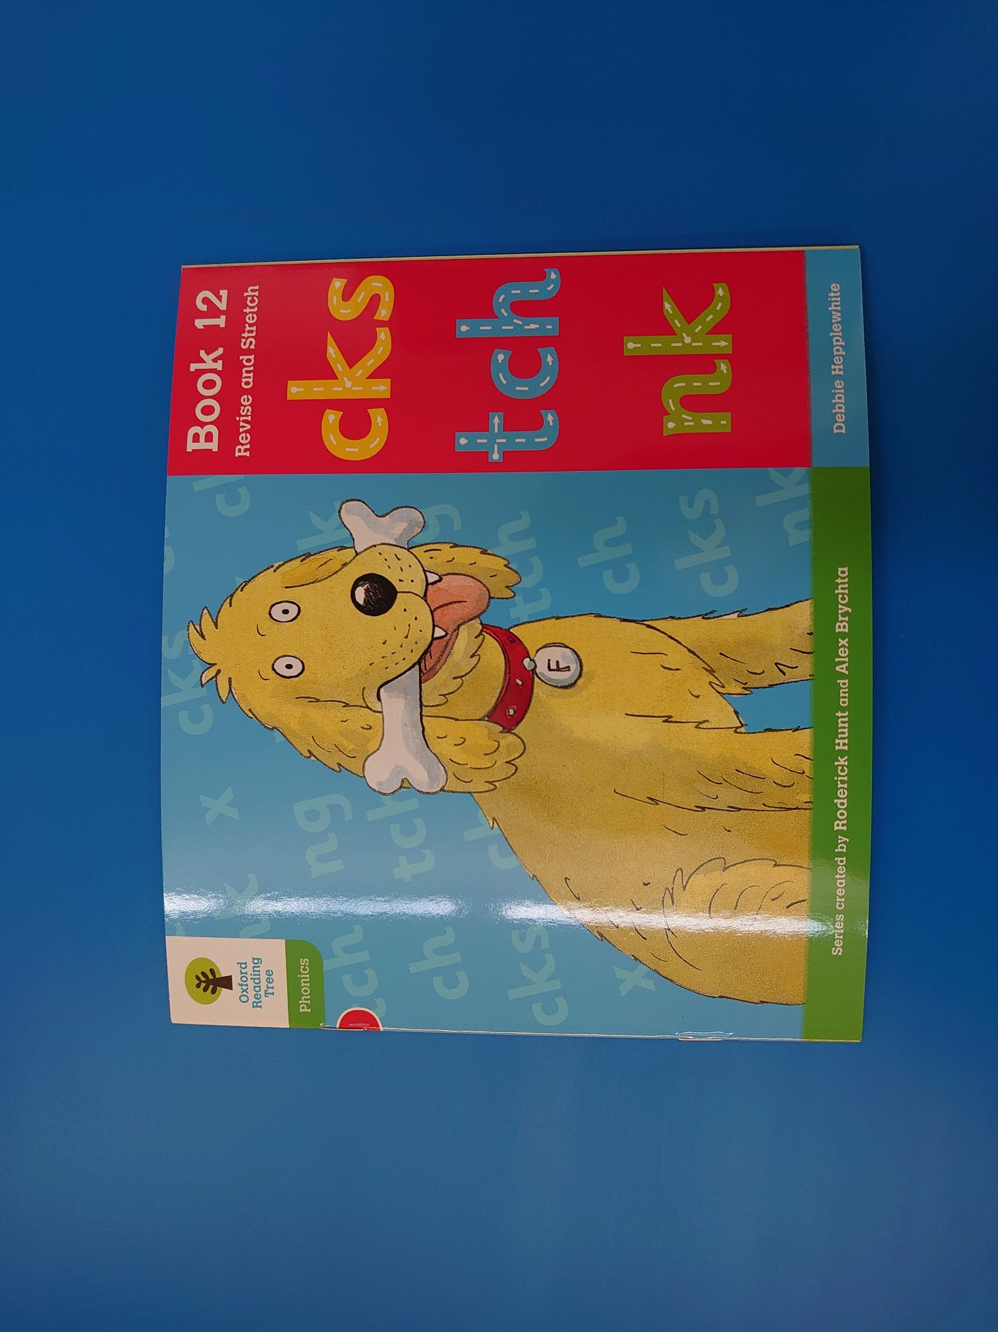

Slide 15
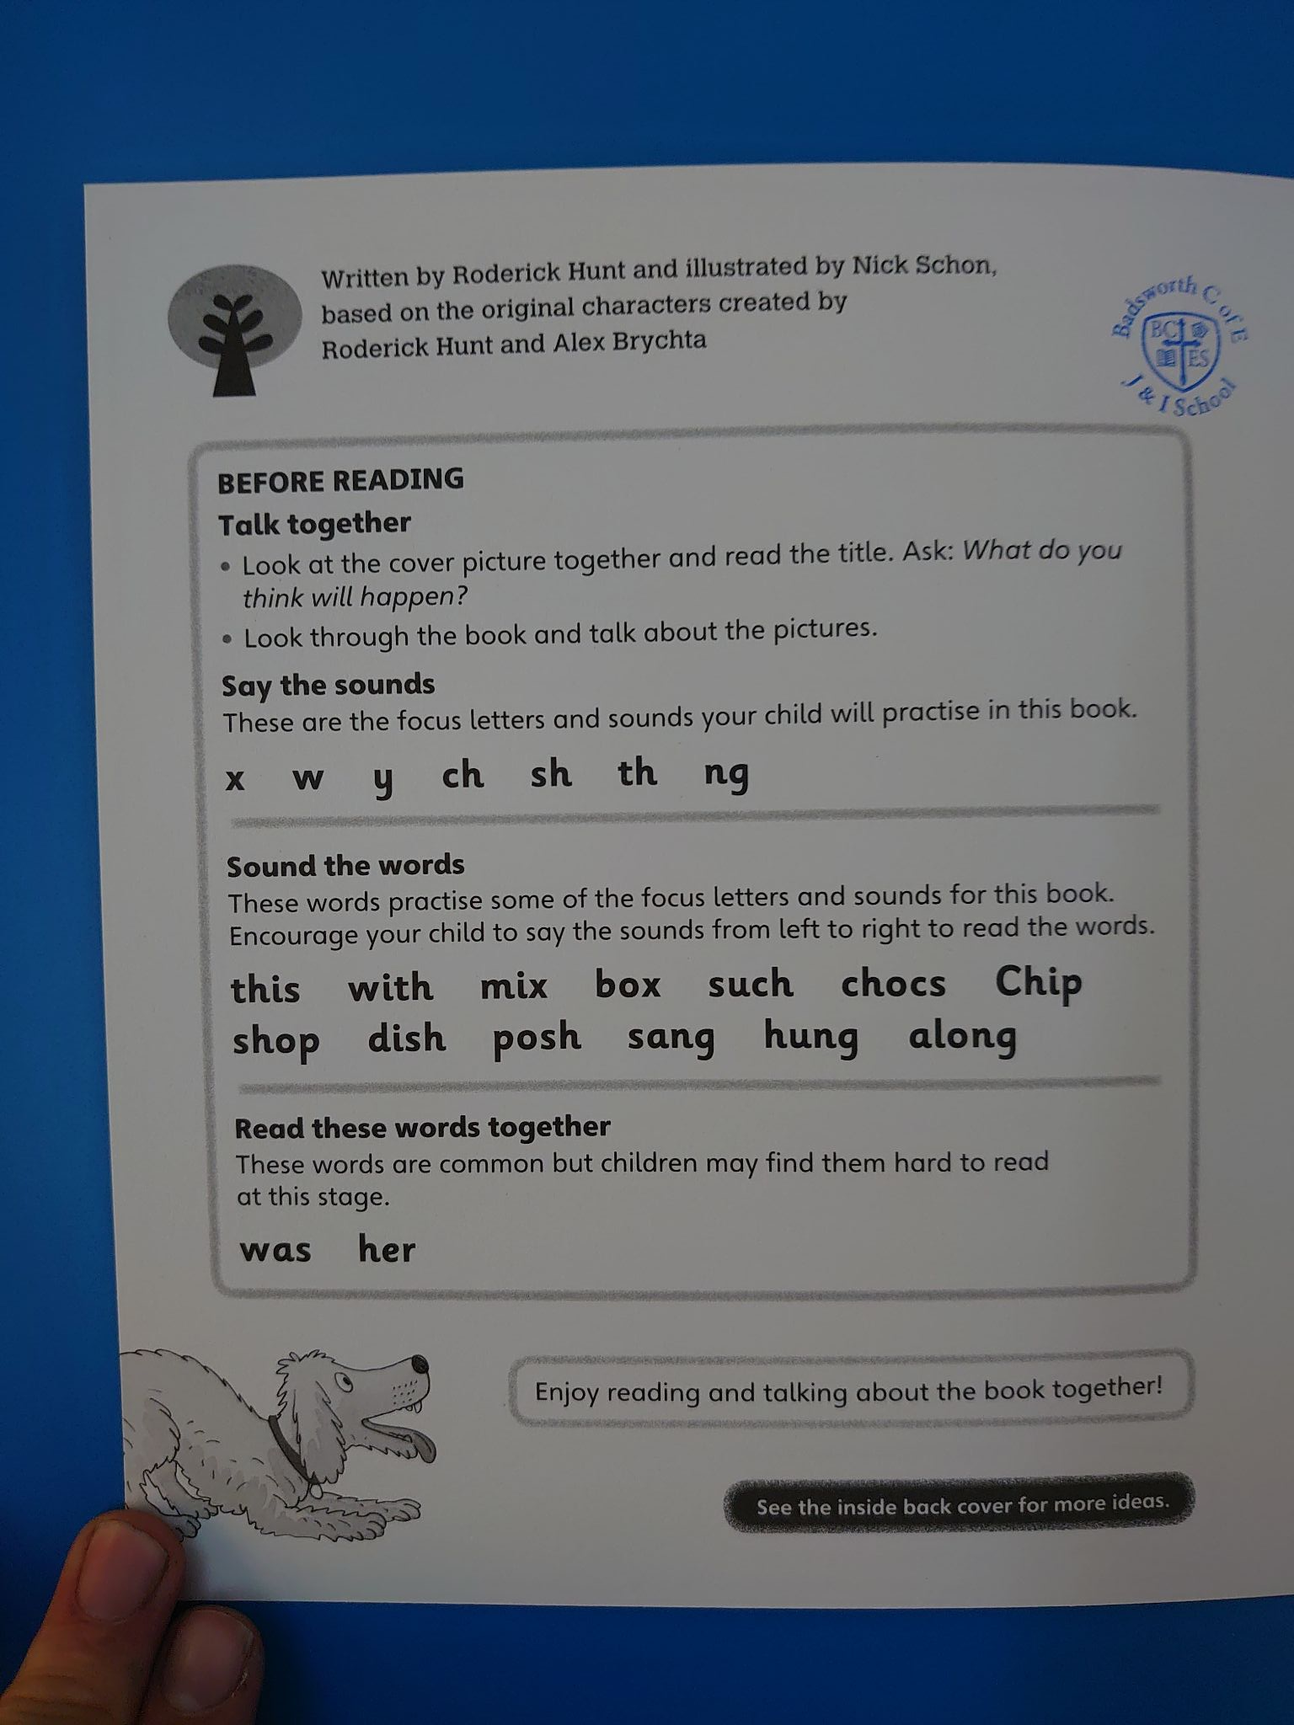
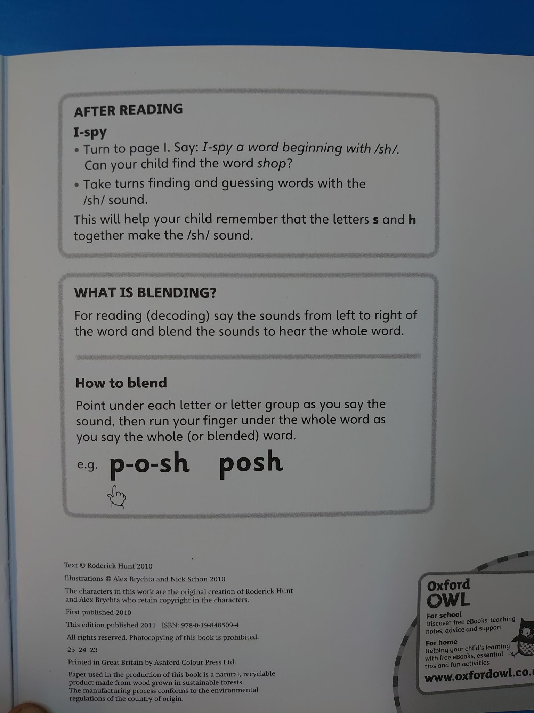
Notes:
Books show the progression - so revisit and review is key to recalling prior learning.

Slide 16


Slide 17
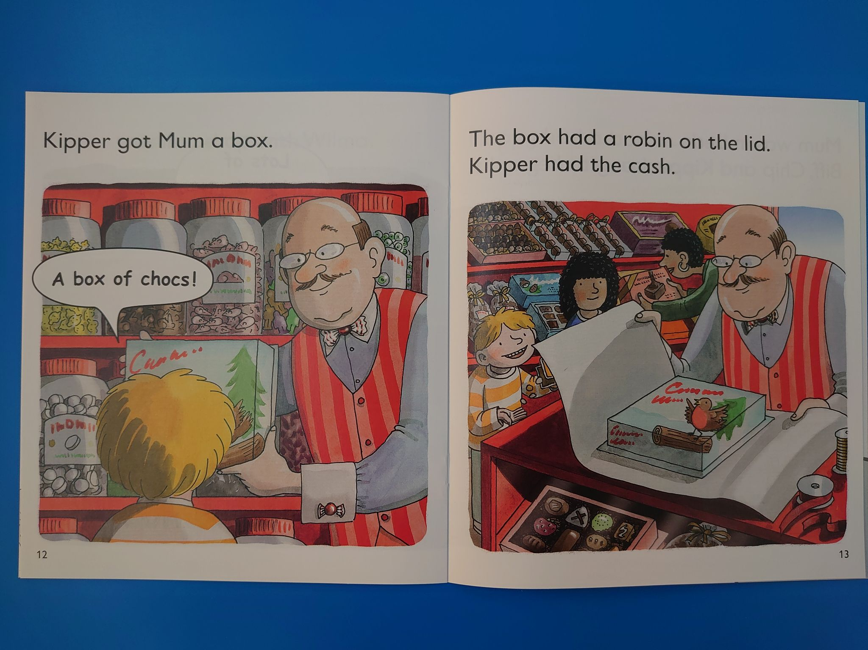
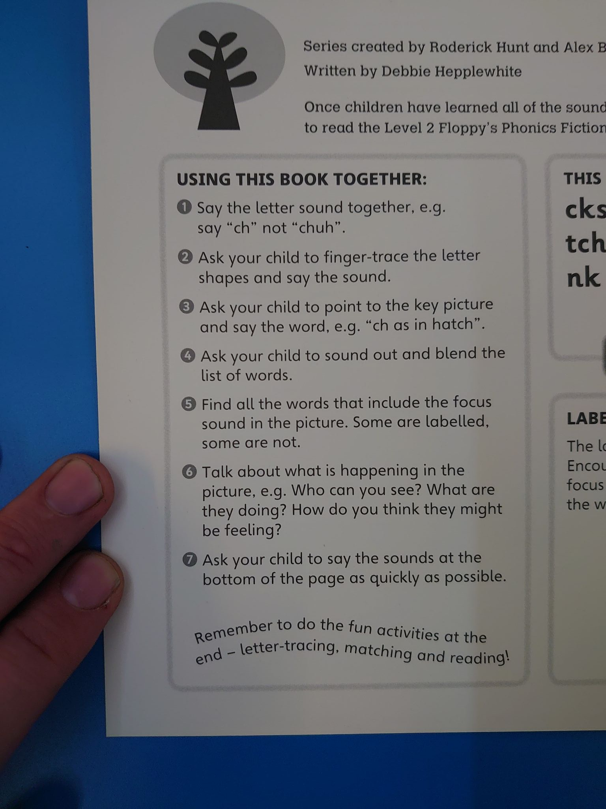

Slide 18
The intent of home readers.
We would like you to:
Enjoy interacting with the books - not just saying the sounds and reading the text!
Make use of the prompt pages for parents and teachers.
Encourage children to make predictions, ask questions and form opinions about what they read.
Complete the supplementary phonic ‘Revise/Revisit’ worksheets.
That the books and resources go between school and home daily to allow continuous learning and consolidation.
Notes:
Incidental teaching is a huge part of the push - english and reading through the curriculum.

Slide 19
A change for everyone!
This is going to be a real team effort.
There will be opportunities for you to see virtually this style of phonics being delivered by our teachers so that you can become more confident in supporting your children at home.
Persevere with the books - little and often! We must commit the learning to the long term memory through repetition. Doing it once or twice is not enough.
Phonic books will be changed once a fortnight initially as recommended by the scheme. This will increase as learning accelerates.
Book bags (Books and resources) are sent into school daily.
Notes:
Incidental teaching is a huge part of the push - english and reading through the curriculum.

